Slide 1
Team PowerPuffs
Ishita P, Ben M, Catherine C, Ryan Z

Slide 2
NASA Project
Exploring data describing environmental elements across the world
Discovering the relationship between these locations and if the could host a renewable energy plant
Defining new places and opportunities for renewable energy sources
Notes:
Green Foot

Slide 3
Our Goals
Educational website that help users explore data
Filtering & Searching
Map Feature
Accounts to save and download results
JSON, CSV
Notes:
What’s our goals again? → We’re aiming for Educational Website that helps users explore data: (Map) → (Filter / Search) → You may ask “Will there be ways to save my searches?” Definitely → (Accounts, where you can save your searches) → (local copies with realistic & acceptable formats) → (JSON, CSV instead of PDF)

Slide 4
Updates
Finished wireframes
Worked on frontend
Home Page, Search Page, Result Page, Login/Sign up Pages
Studied NASA Data

Slide 5
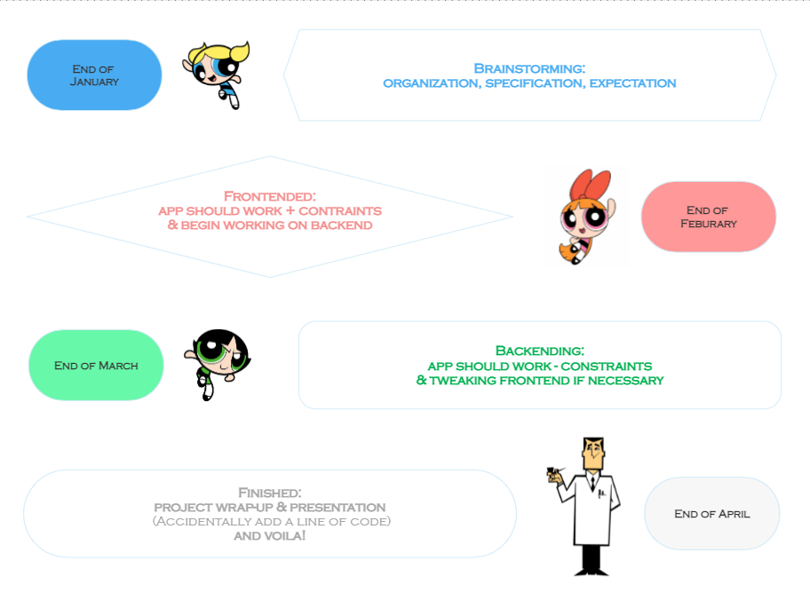


Notes:
In march:
Add pages: about, maybe a landing page
Begin implementing backend which is node, express, mongo
Learn about mongo and design database
Transition files to typescript
Fixing minor details in frontend or endpoints
Start visualizing the data sets

Slide 6
Wireframes

Slide 7
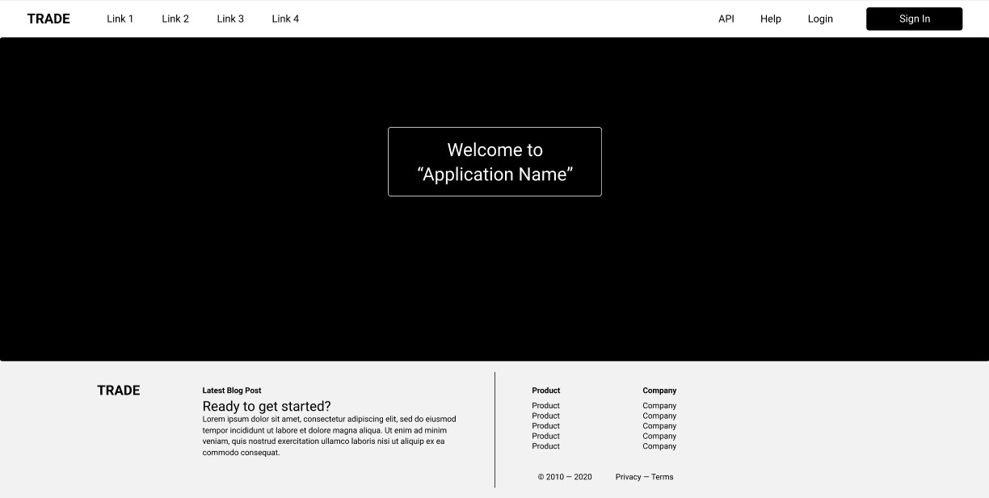
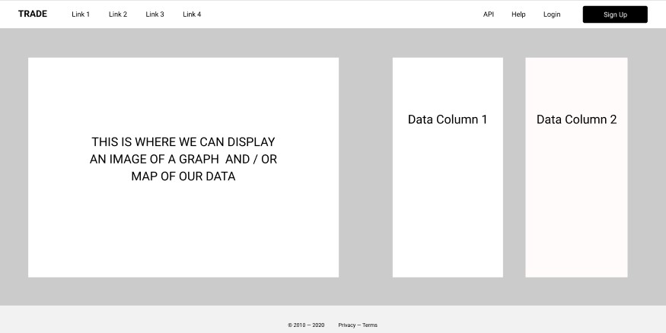

Slide 8
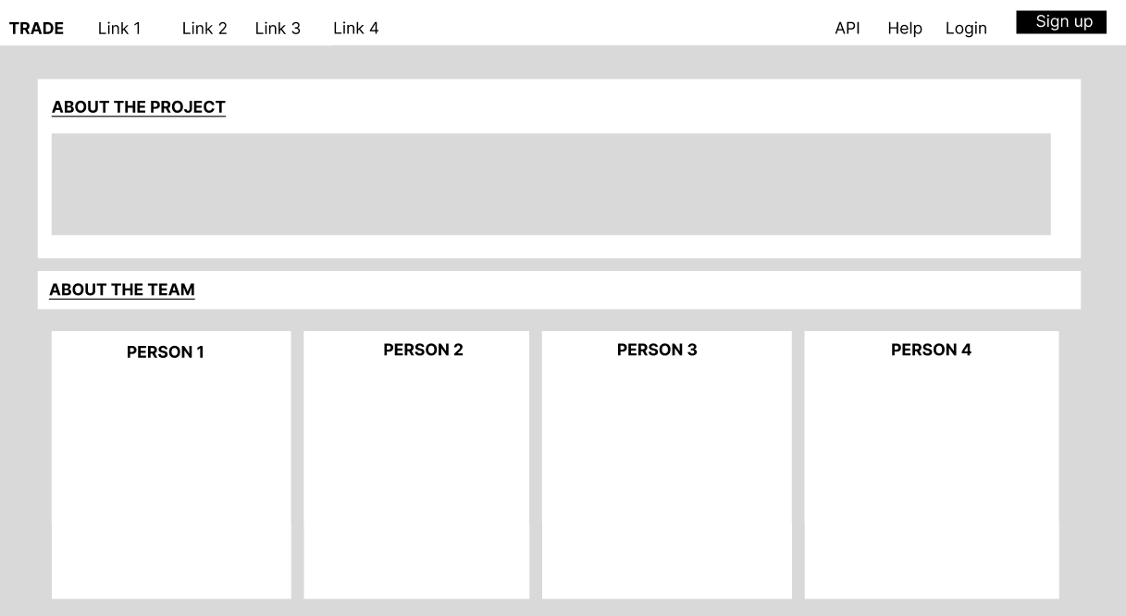
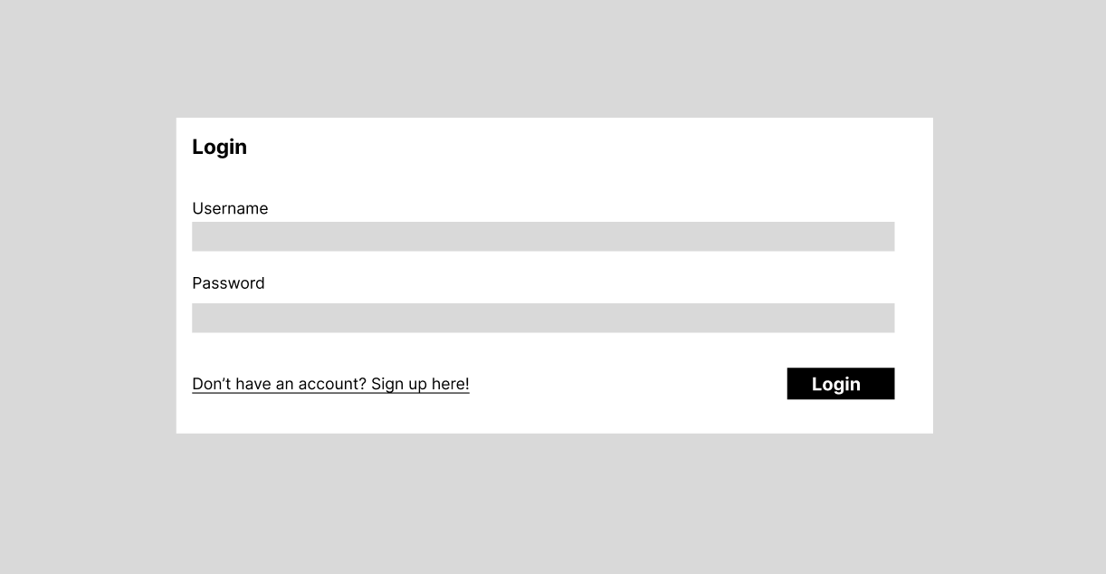

Slide 9
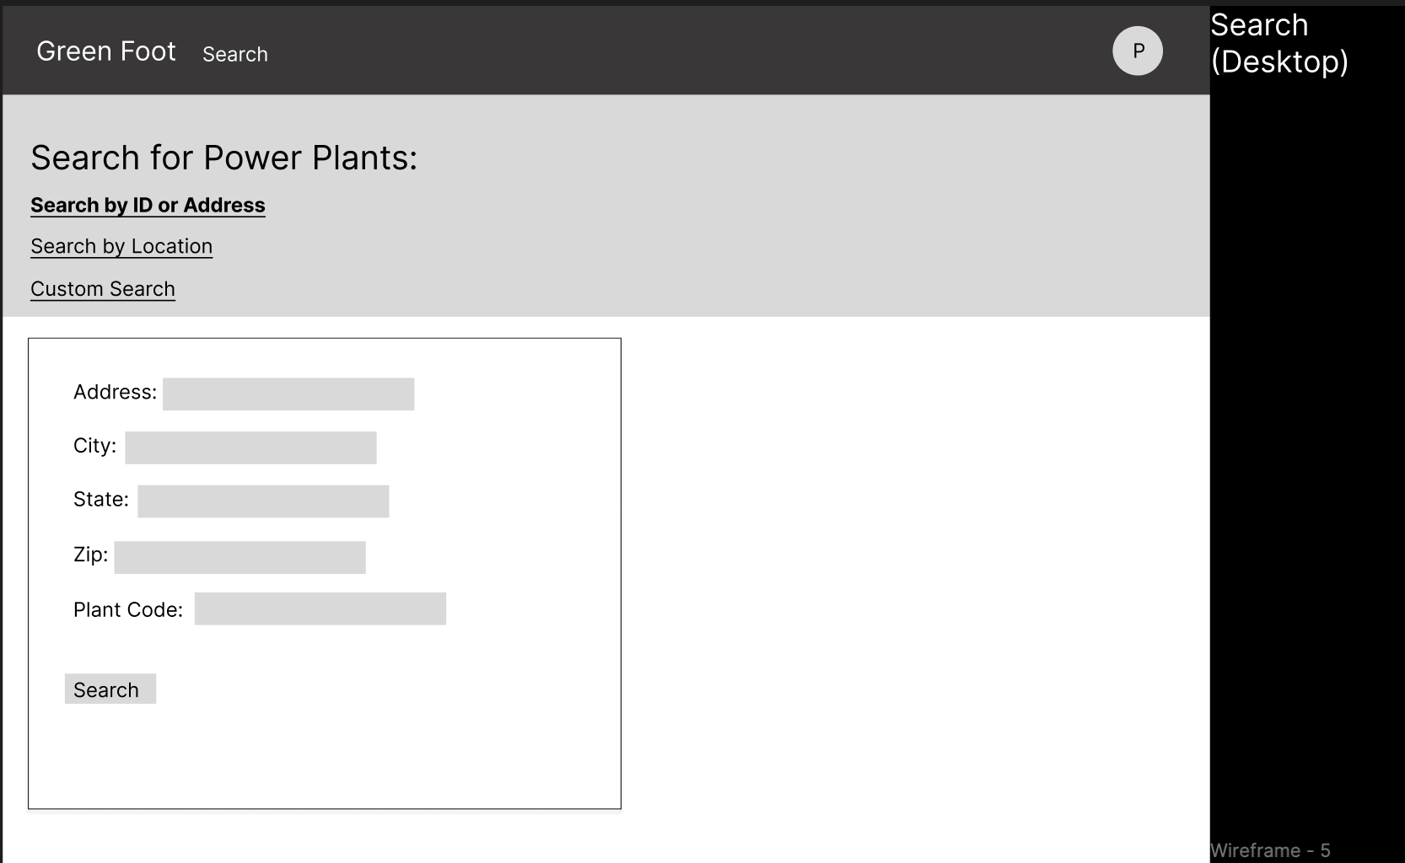
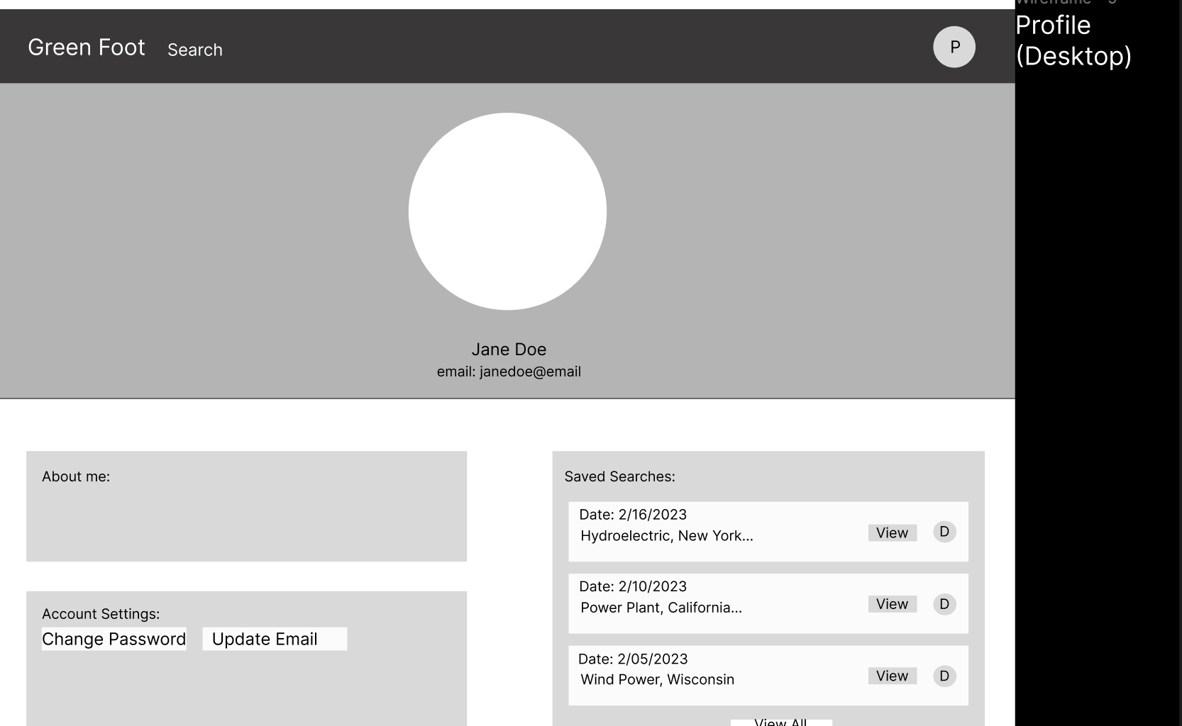

Slide 10
Now for the demo!

Slide 11
Thank You!
Questions?

